Slide 1
Deep learning for developmental challenges
Ernest Mwebaze, PhD
Sunbird AI & Makerere AIR lab

Slide 2

How can deep learning help?
Shortage of experts to perform time-intensive tasks
Limited standardization in executing expert tasks
Limited resources affecting the scale of research

Slide 3

How can deep learning help?
Shortage of experts to perform time-intensive tasks
Limited standardization in executing expert tasks
Limited resources affecting the scale of research

Slide 4
Applications in Agriculture from the AIR lab

Slide 5
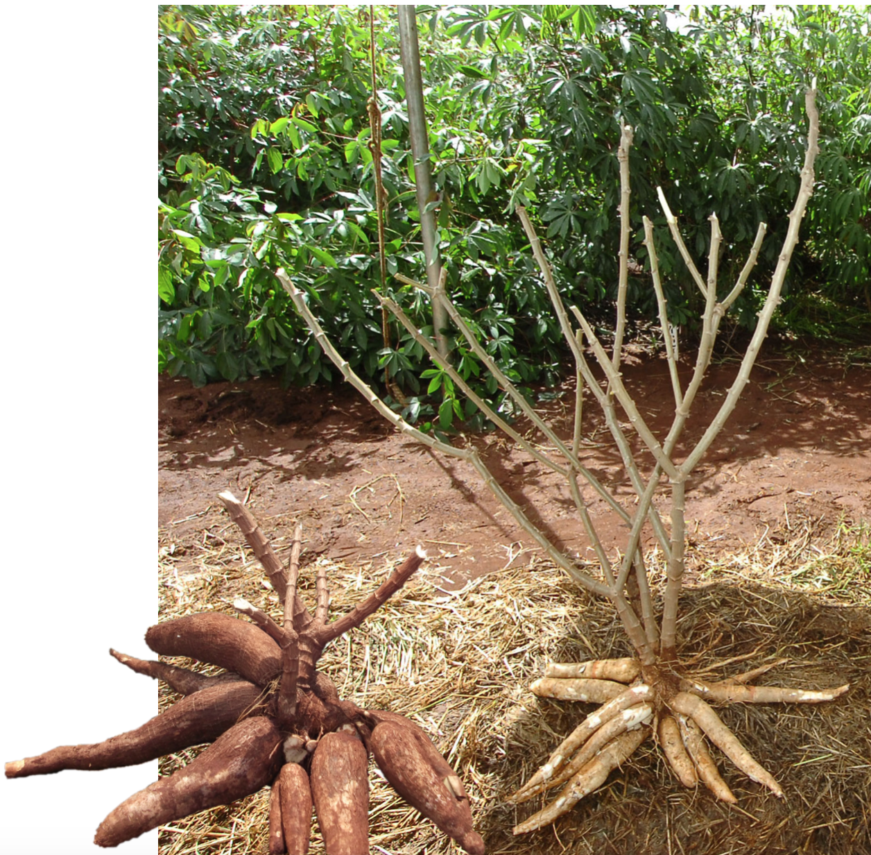
What is the biggest agricultural problem?
Cassava - a shrub with an edible root tuber.
It’s a food security crop, offers the 3rd largest source of carbs but mostly it’s robust under diverse weather conditions.

Slide 6
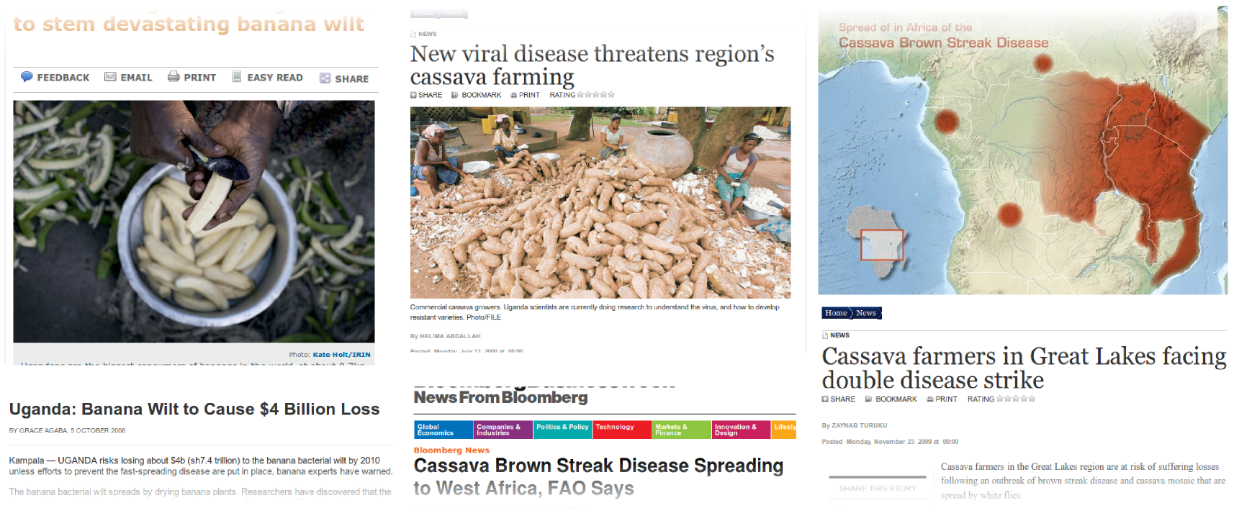
Cassava supports over 75% of all farmers livelihoods in Uganda.
Heavy losses due to Cassava diseases - identifying disease is a challenge.

Slide 7
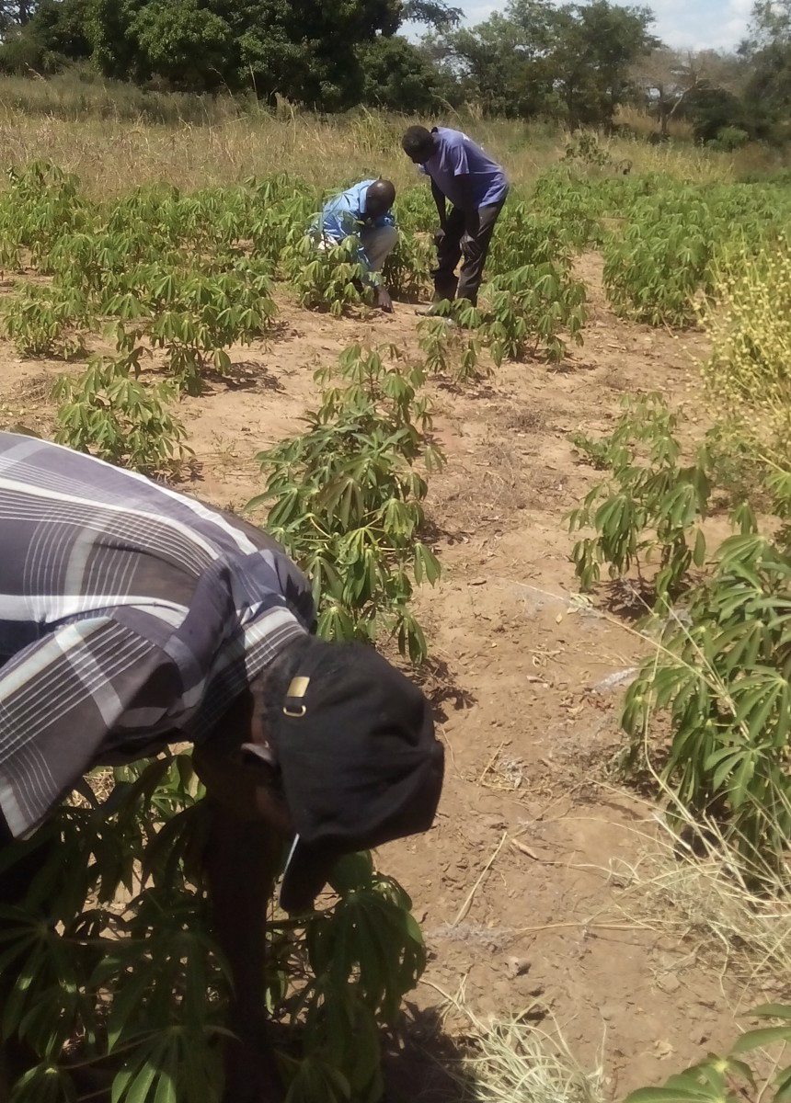
Challenge 1: Disease diagnosis - resource expensive (experts, time, money)

Slide 8
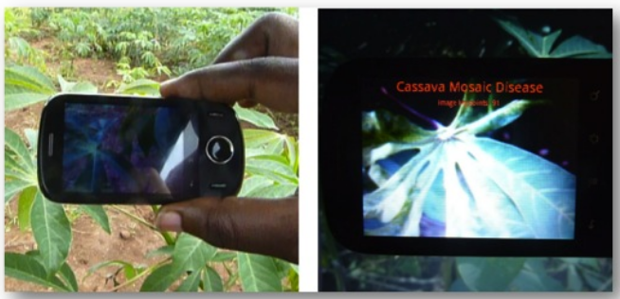
Smartphone based diagnosis using leaf images
http://air.ug/mcrops/

Slide 9
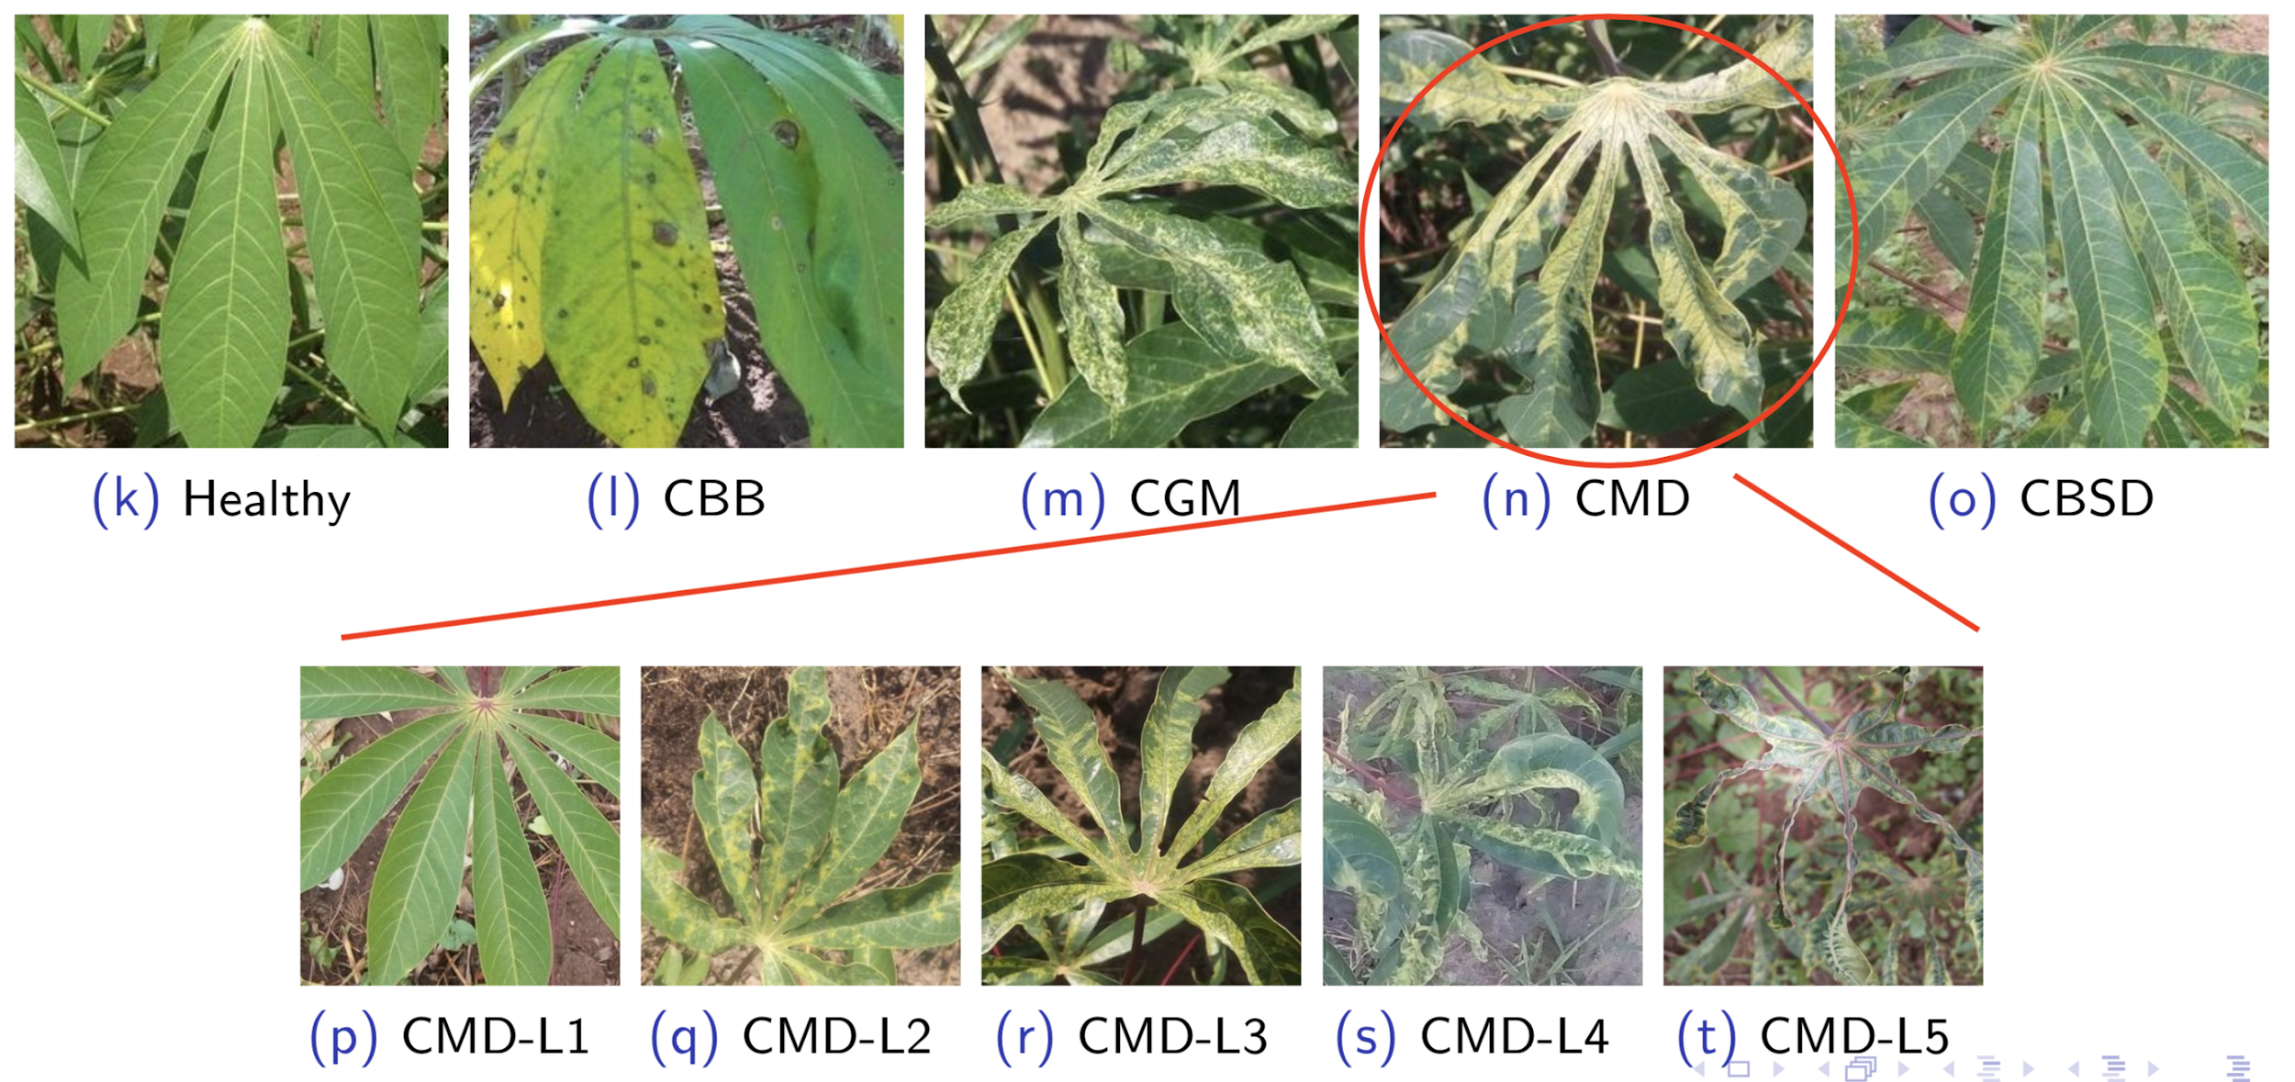
Cassava leaf image data

Slide 10
Data collection
Several considerations
Single leaf vs whole plant
Background vs no background
Single class vs multiple classes

Slide 11
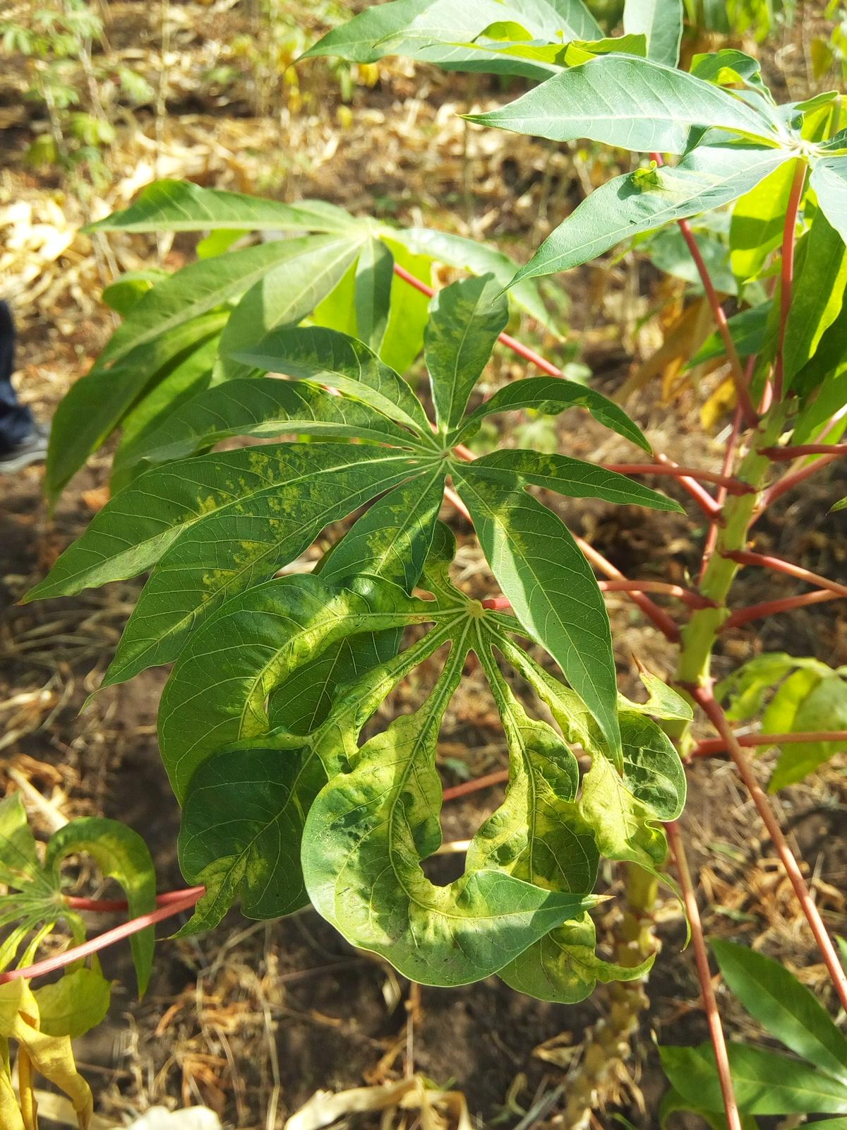
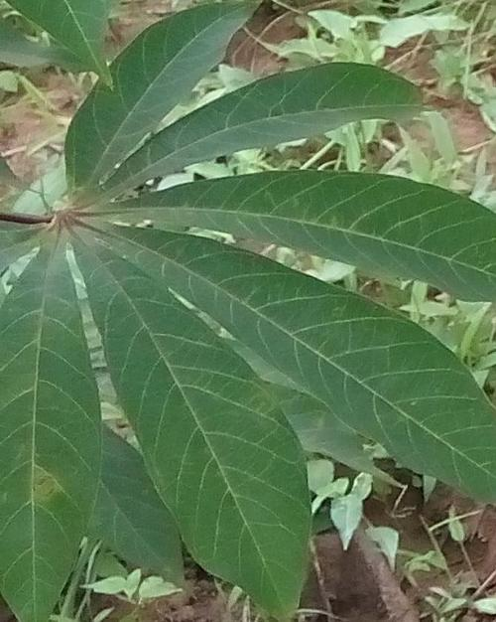
Data collection
Single leaf vs whole plant
Background vs no background
Field image
Image presented
for training model

Slide 12
Data annotation
Single label
Label: Cassava Mosaic Disease

Slide 13
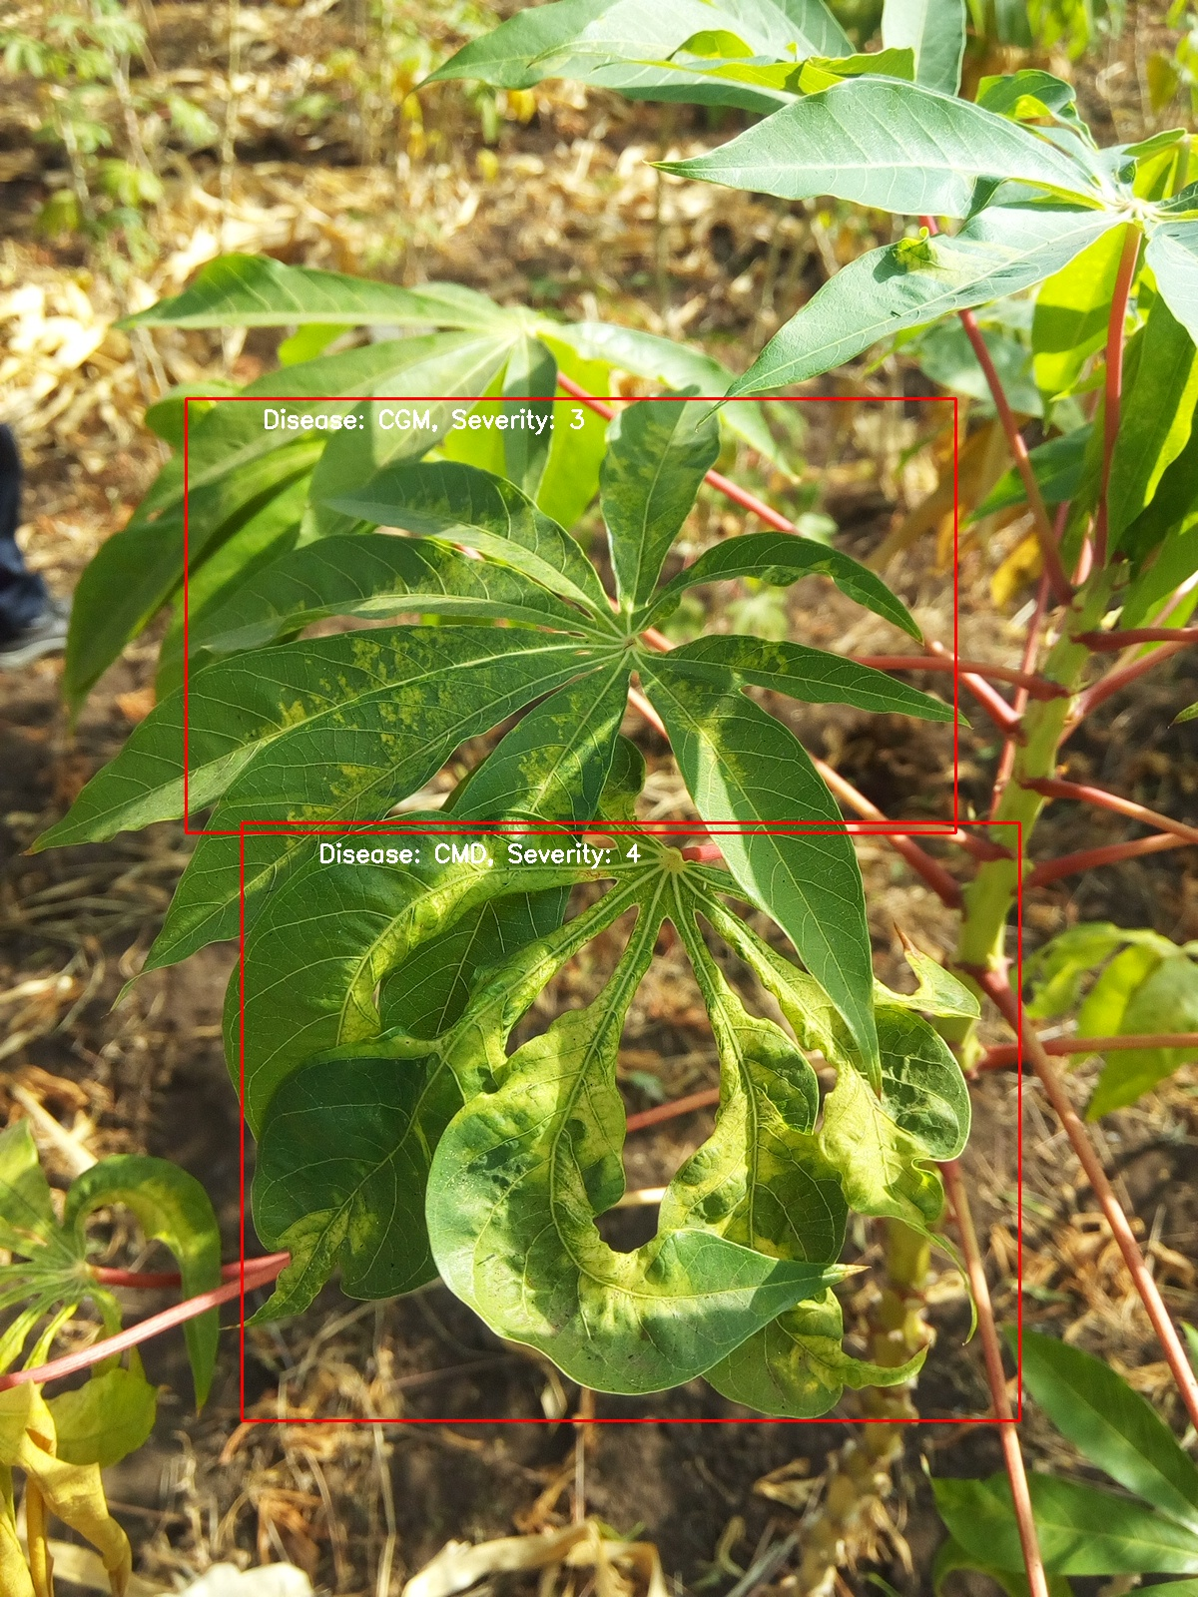
Data annotation
Multi-label, bounding boxes
Label: Cassava Green Mite
Label: Cassava Mosaic Disease

Slide 14
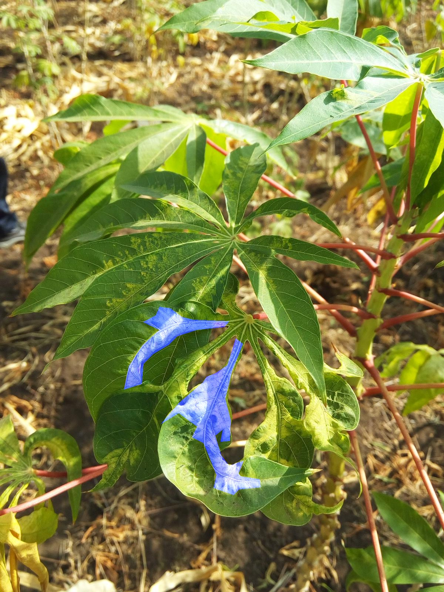
Data annotation
Pixel-level semantic segmentation
Label: leaf area with cassava mosaic disease

Slide 15
Data annotation
How long does it take to annotate 100K images?
It’s an expert task
Images supplied by farmers

Slide 16
Modeling
Assuming we go with a CNN, several considerations.
Which architecture?
Number of classes?
Image quality at input?
Input image or video?
Transfer learning? Data augmentation?
Size of trained model?

Slide 17
Model evaluation and validation
Some considerations
Accuracy? what’s sufficient accuracy for this application?
What about errors? anything to learn there?

Slide 18
Deployment
Some considerations
Phone? Quantization of models?
Phone display?
Authority/guarantee of result?

Slide 19
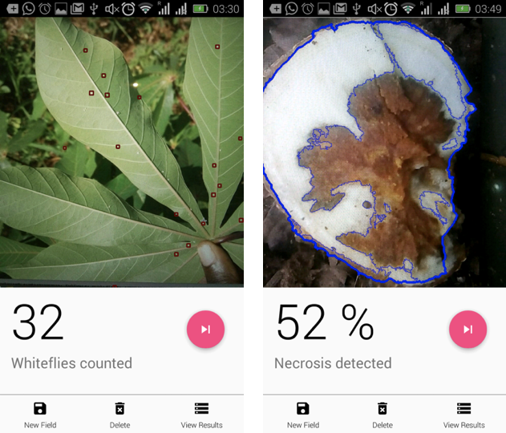
Challenge 2: Pest and symptom measurement
Apply computer vision to automate measurement of disease pests and symptoms

Slide 20
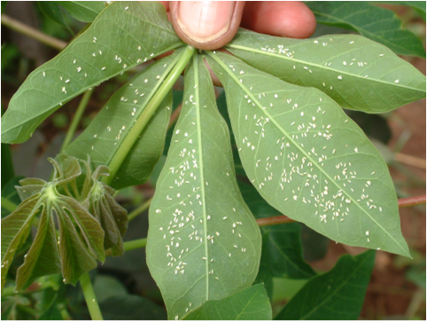
Whitefly count
Counting whiteflies on 30 plants per field, 5 leaves per plant,
7 lobes per leaf, very early in the morning.

Slide 21
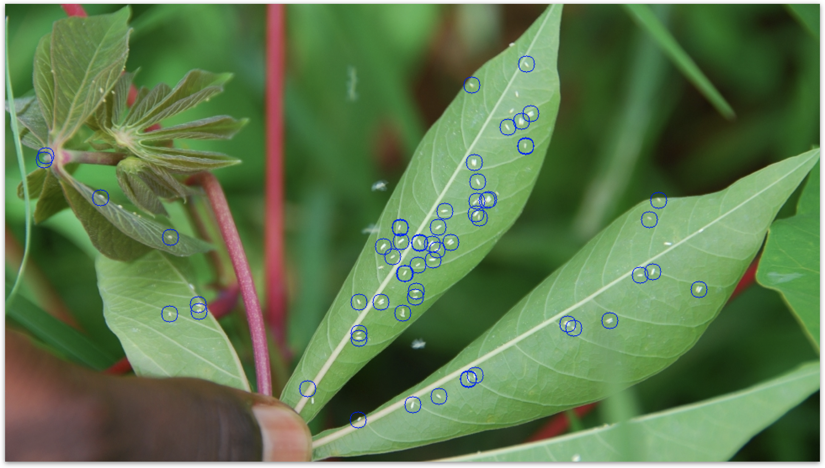
Inherent inaccuracies in measurement

Slide 22
Data collection and annotation
Some considerations
Resolution of images
Background
Classification vs object identification
Labeling? pest clusters, flying pests, background, etc

Slide 23
Modeling and evaluation
Some considerations
Architecture? R-CNNs? YOLO?
Input image or video?
Classification vs object identification
Labeling? pest clusters, flying pests, background, etc
Accuracy of count? Precision?

Slide 24
Deployment
Some considerations
Phone vs online?
Integration

Slide 25
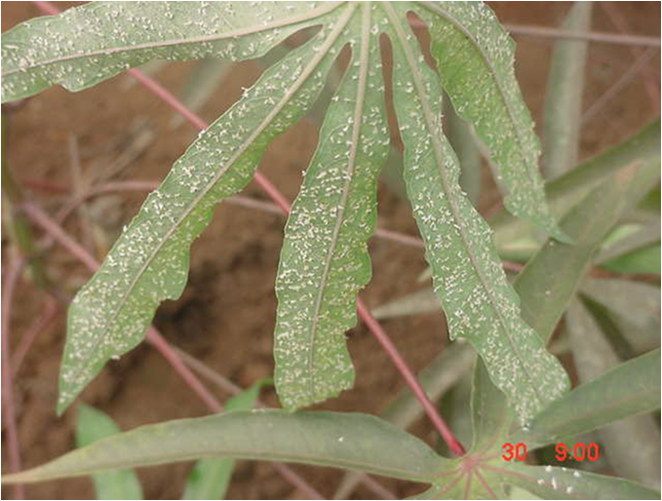
When things break down...

Slide 26
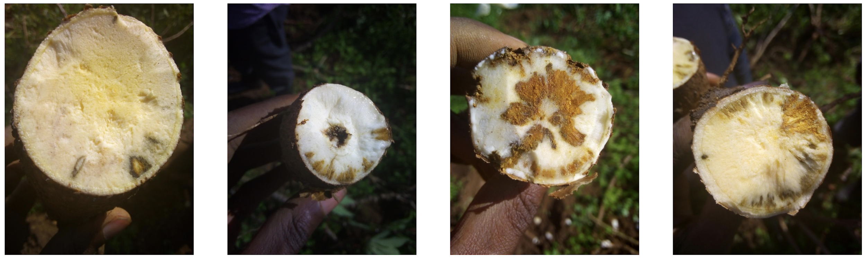
Necrosis detection
Determine proportion of root cross-section that is necrotized (brown)

Slide 27
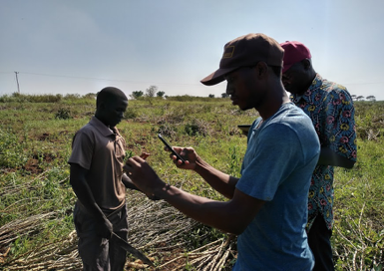
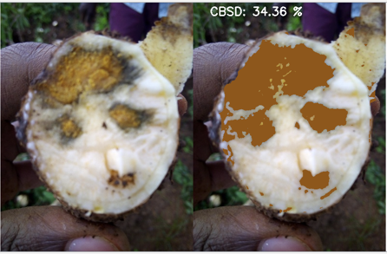
The challenge for DNNs
Field based
Alignment with existing protocols

Slide 28
Data collection and annotation
Some considerations
Destructive data collection
Image quality artifacts e.g. shadows, soil
Labeling? what is necrosis, what is soil, damage?

Slide 29
Modeling and evaluation
Some considerations
Architecture?
Transfer learning
Domain validation/evaluation
Inference time

Slide 30
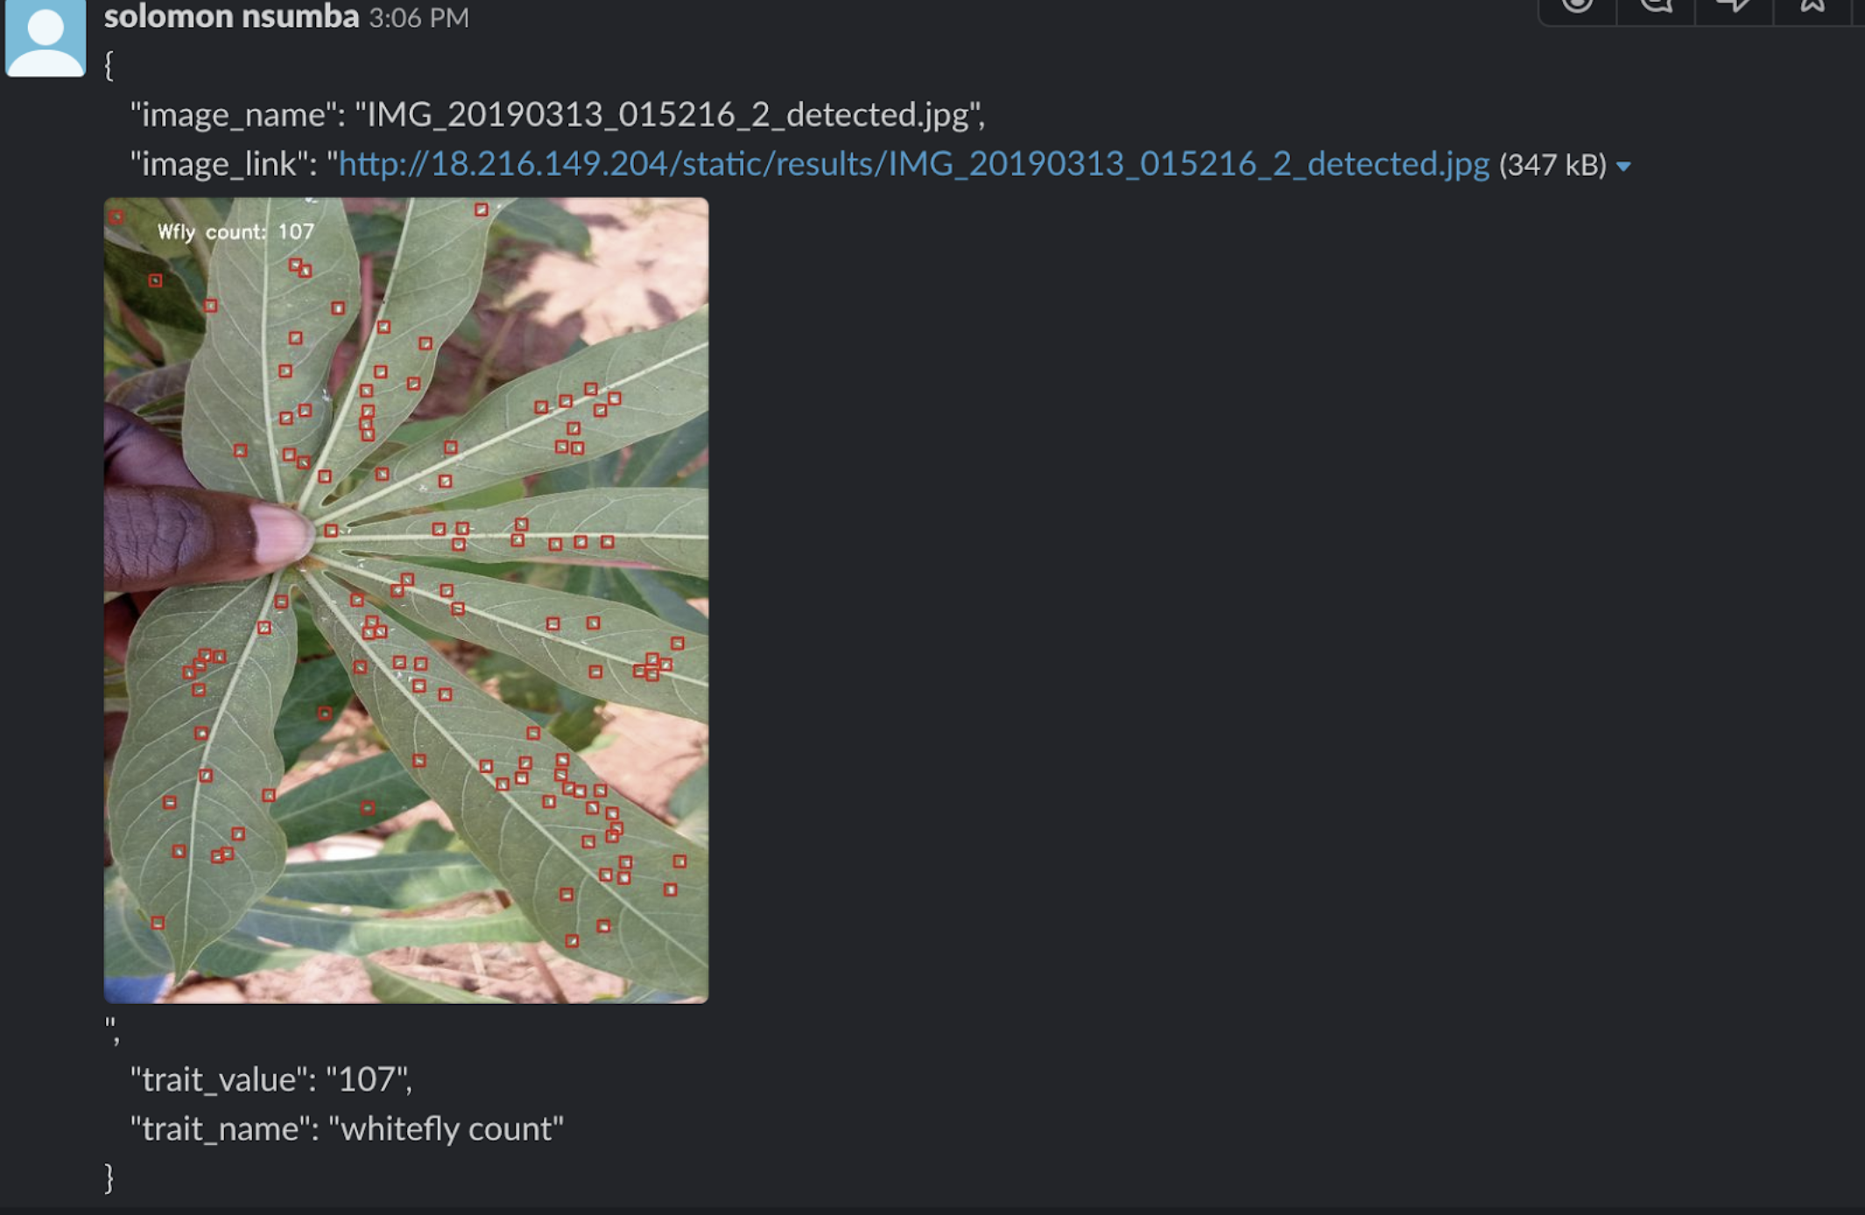
Current deployment - whitefly count

Slide 31
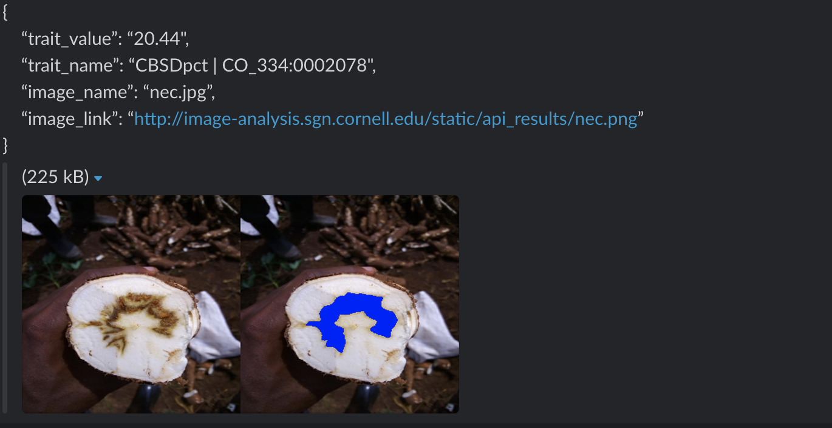
Current deployment - Necrosis detect

Slide 32
Conclusion
Data collection and annotation
Problem definitions - redefinition?
Evaluation and validation - human-in-the-loop?
Model maintenance - swappable model apis?
Remote vs local deployments
Transfer learning

Slide 33
Thank You

